Slide 1
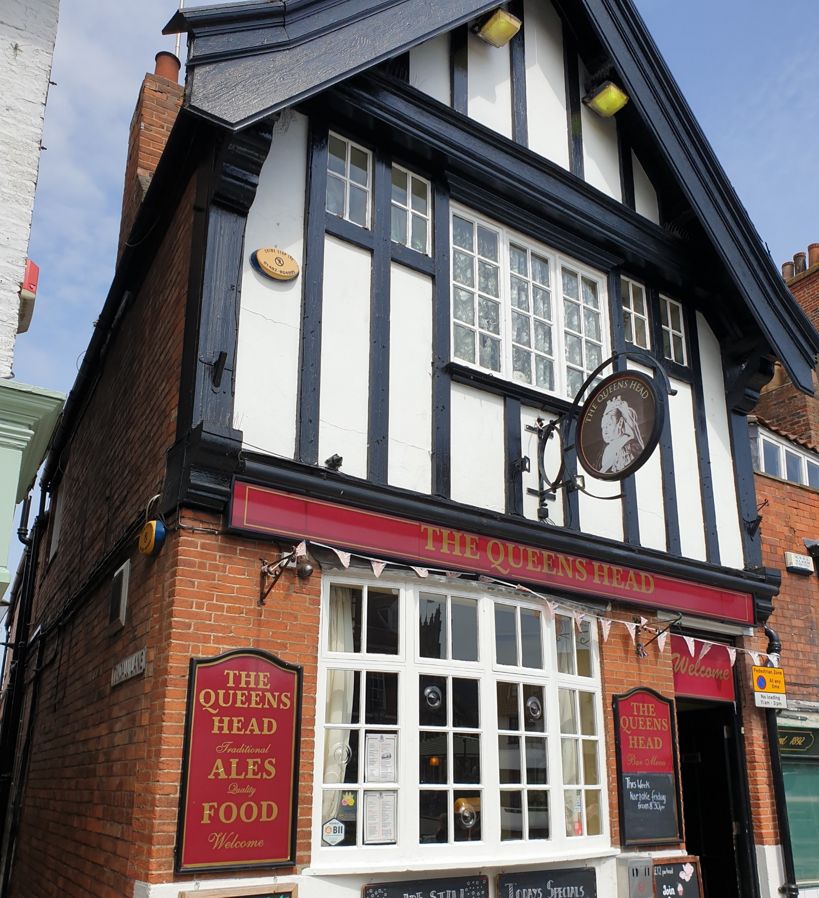

Beverley Treasure Trail
Tuesday 11th August, 6.45pm
Start Queen's Head Pub
Wednesday Market, Beverley, 6.45pm
You are given directions and a series of questions to answer as you
have a leisurely walk of approx. an hour and a half.
Finish back at the pub
Come and join us, friends are most welcome
£8pp max 4 per team
Coffee and cake included
To book your place:
Please email info@eastyorkshire.foodbank.org.uk
(Payment required in advance)
Charity number: 1167071 Registered in England and Wales

